Slide 1

MUSIC
Group 16
Akriti Bhatnagar
Nandeep Nanjappa
Vinod Subramanian
Understanding the Music Rater Characteristic
Notes:
Greetings from Group 16. This is Akriti, Nandeep and Vinod with our pecha kucha on understanding a music rater and his characteristic

Slide 2





Problem Overview
Notes:
Understanding the user who rates online music is a challenge given so many variables such as varying tastes, preferences, biases, attention spans, etc.
We decided to explore this theme and came across a huge dataset published by Yahoo Music and wanted to explore that data to see what the data told us about the rater
Yahoo Music was the number one online music site in terms of audience reach and total time spent in March 2007
Sometime in early 2013, Yahoo Music deleted its entire database of artists, and their albums & songs as well as the users' ratings. However, music videos continue to be accessible.

Slide 3
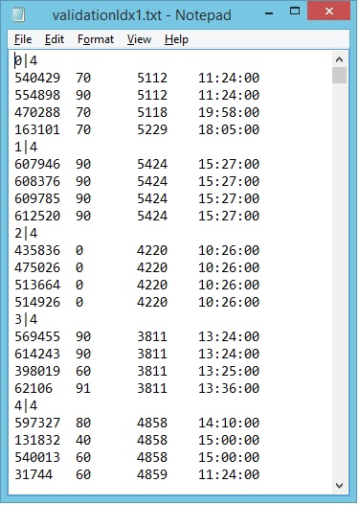





ABout the Raw Data
Volume
Size
4 Million rows
~130 MB
The dataset contains ratings provided by true Y! Music customers during 1999-2009
Variety
Metadata
http://webscope.sandbox.yahoo.com/catalog.php?datatype=c
Notes:
The Dataset represents a snapshot of the Yahoo! Music community's preferences for various musical items
A distinctive feature of this dataset is that user ratings are given to entities of four different types: tracks, albums, artists, and genres.
The dataset contains ratings provided by true Y! Music customers during 1999-2009
Both users and items are represented as meaningless anonymous numbers so that no identifying information is revealed
Of the huge 10GB dataset package provided, we picked up the training dataset that had 4 million rows with a size of ~130 MB and which gets truncated when opened in excel
The dataset provided in txt format required transformation and derived column that would provide some insights

Slide 4

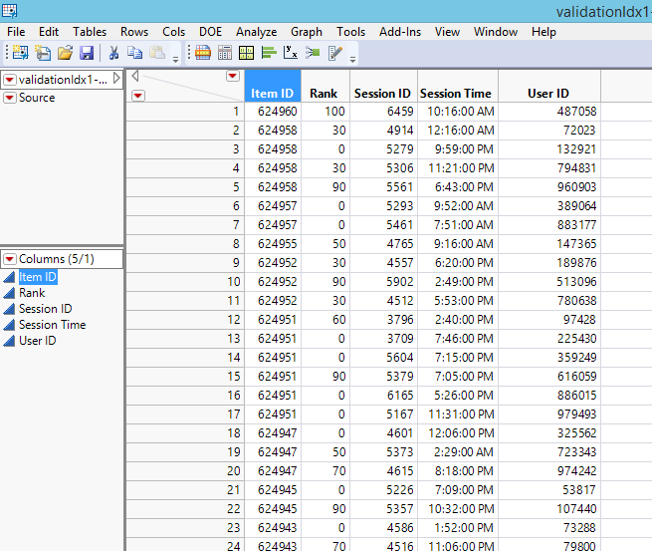
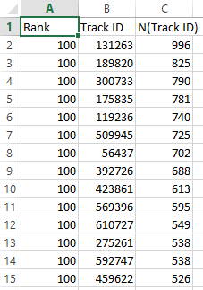

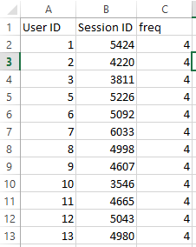
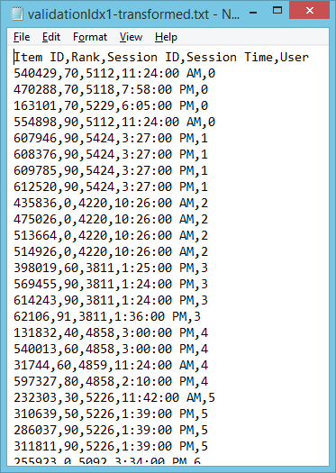
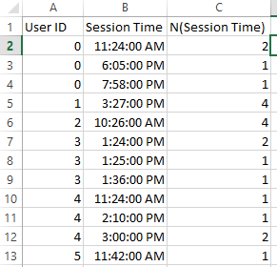
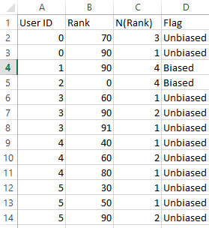

Data Preparation
Aggregates
Raw
Transform
Average 2 million rows each
csv
txt
JMP
4 million rows
txt
Notes:
Data preparation involved taking the raw unstructured file and transforming it into a structure
JMP was used to enable the transformation and organize the data into structured format
For insights and analysis purposes, JMP was also used to create aggregates and bring in derived columns
These transformed and aggregates files were stored as csv’s

Slide 5
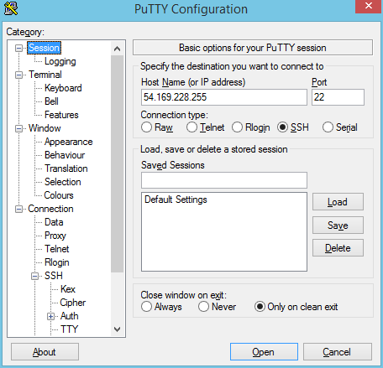
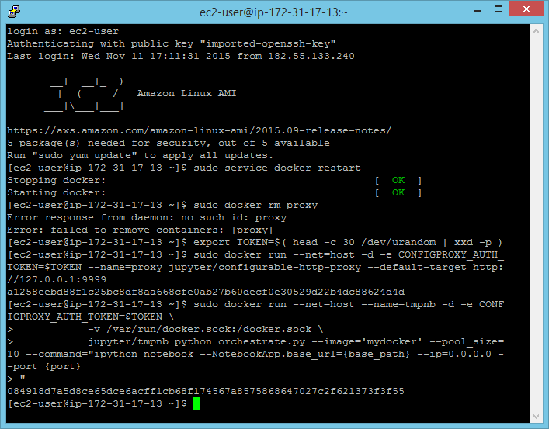
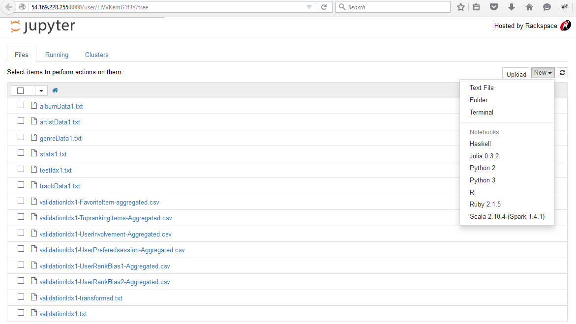
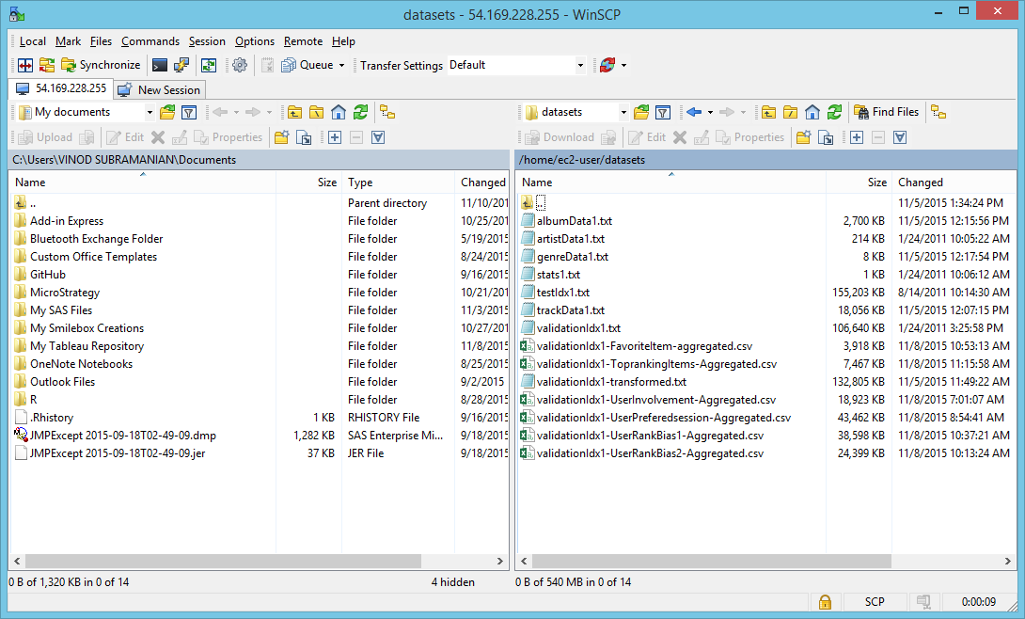
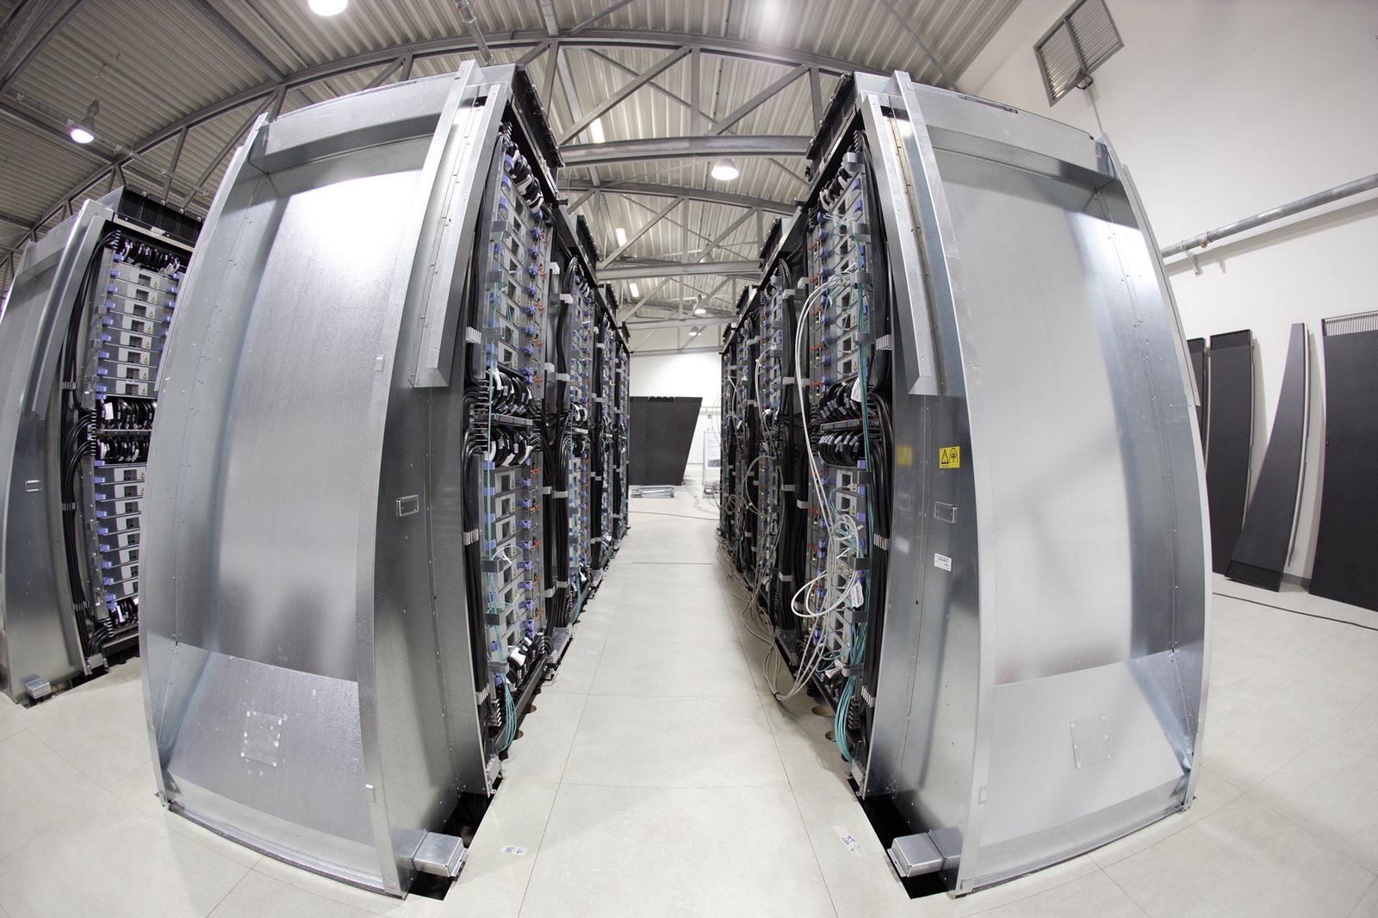
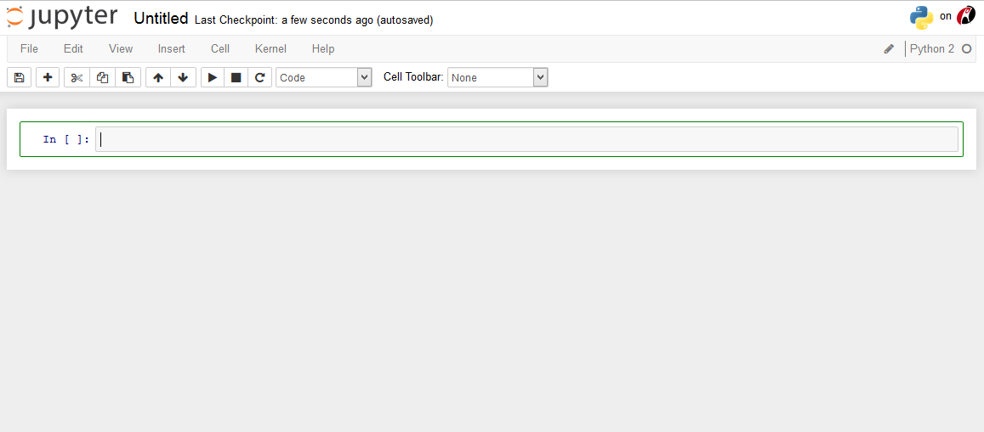
Infrastructure Preparation
Step 3: Docker and tnpmb Server Setup
Step 4: Mount datafiles in container
Step 5: Jupyter Launch
Step 2: SCP
Step 1: Instance
AWS EC2
8 vCPUs X 32 GB Memory X 30 GB SSD
EBS
Amazon Linux
Additional Technologies successfully explored
Import data into Anaconda instance
Import data into UBUNTU Server
Analysis
Step 6: Pyton Notebook
Notes:
We explored and worked on a number of technologies such as setting up anaconda instance on aws EC2, anaconda on Ubuntu server and docker tmpnb server on aws EC2
We would like to single out the support provided by our colleague Frans Siswanto for his guidance during our starting challenges. And Wai Tuck for his clarifications and guidance
Infrastructure involved the following steps
We decided on 8vcpu’s, 32 gb memory and 30 GB storage aws ec2 instance considering the amount of processing required and volume of data
As data was huge and had challenges to upload files via jupyter notebook upload option, we had to resort to SCP. WinSCP was used to transfer files to EC2-user instance
Docker and tmpnb server was setup. We encountered another situation when the datafiles transferred did not reflect in the docker image
This required a set of mount scripts with which we could get to mount the files into docker image
These steps helped us launch Jupyter notebook and start ipython coding

Slide 6
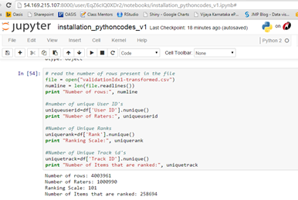
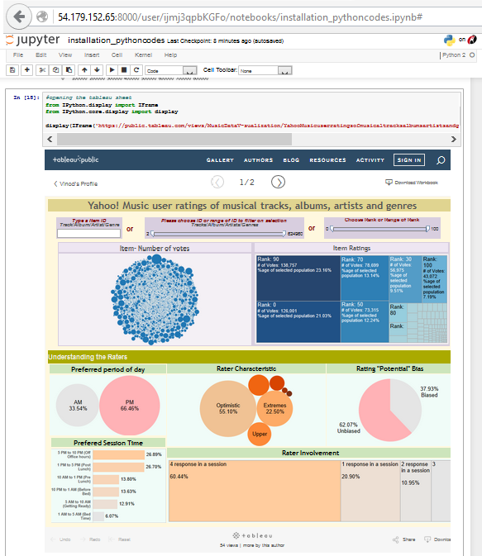
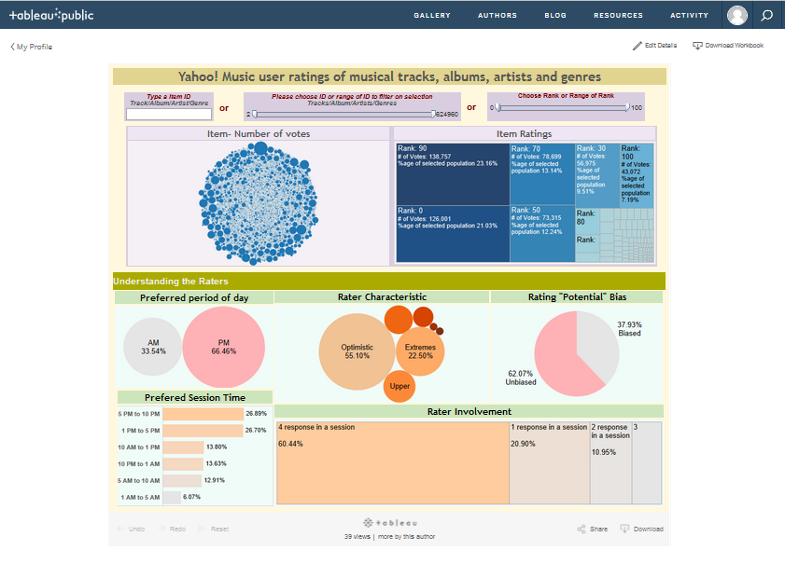
Analysis Approach
Step 1: Data Exploration
Step 2: Data Visualization
Run Python script and produce basic stats
Run Python script to open Tableau Server Instance
Notes:
We took a two stage approach to our analysis
Step 1 included data exploration
Step 2 included data visualization
Data exploration involved using python code to view basic descriptive stats and plots on the 4 million transformed and aggregated dataset
Data Visualization involved launching tableau server dashboard inline in the notebook for enabling interactive visually appealing visualizations

Slide 7
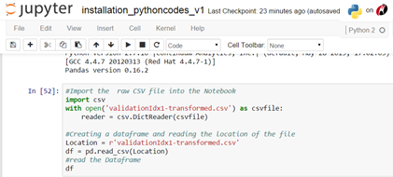
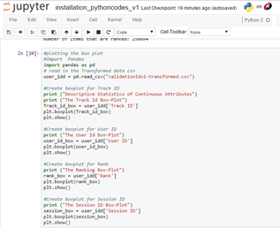
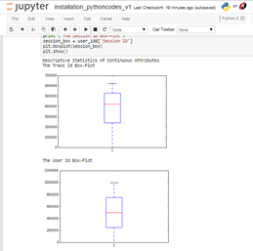
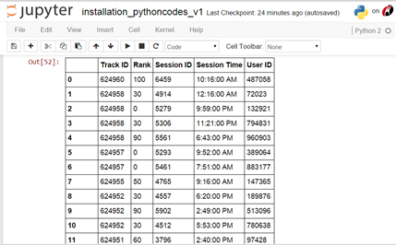
Step 1: Data Exploration
Almost Normal distribution with some attributes showing small skewness
Notes:
The 4 million dataset was read into a dataframe and was used to perform some basic descriptive analysis such as row counts and box plots
This was used to understand distinct counts of each attribute we were dealing with and also the distribution of these attributes.
The box plot showed us that we had an almost normal distribution for the attributes

Slide 8
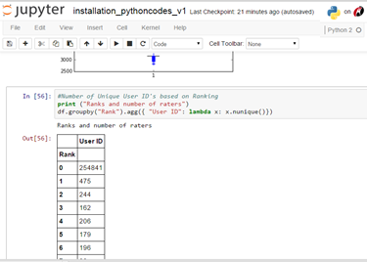
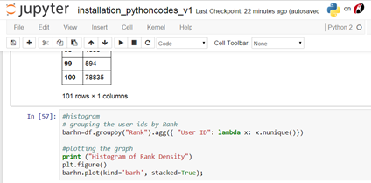
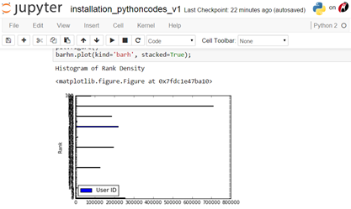
Step 1: Data Exploration
Histogram shows that maximum items were voted for ranks
Notes:
An aggregated dataset was created from the 4 million raw file and read into a dataframe.
This was to understand the distribution of number of distinct users to rank in the training dataset
A Histogram was attempted to make this visualization

Slide 9
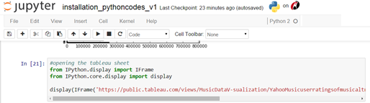
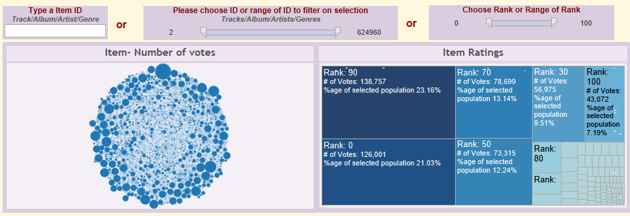
Step 2: Data Visualization
Item and Rating Dashboard
Provide Interactive visualization of
Number of Votes for an Item or Range of Items
Ratings Characteristics for the Item range
Notes:
The first half of the dashboard is interactive where a user can visualize in a bubble cloud, which item was voted more often and
the corresponding treemap view of the number of votes for which rating
The user could choose directly an item or a range of items or range of rank to interactively visualize the user ratings on items and the ranks

Slide 10
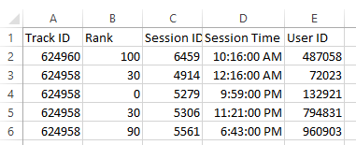
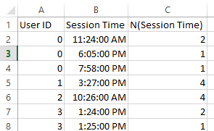
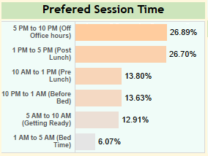
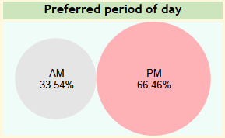
Step 2: Data Visualization
Rater Characteristic Dashboard
Derived From Session Time using Tableau Parameters
Period of Day formula: (AM or PM)
TRIM( SPLIT( [Session Time], "00", -1 ) )
Derived From Session Time using Tableau Binning
Data grouped into 6 bins (Based on Key time periods in a day of a Rater)
Notes:
From the aggregated data we derived the following rater characteristics
The period of the day when most users voted. As can be seen 66% voting happened in the afternoon/evening
Also as seen in the adjacent graph. Most voting took place in two periods
1 PM to 5 PM which can be attributed to post lunch session most likely
5 PM to 10 PM which could be attributed to off office hours (travel back home, post dinner time)

Slide 11
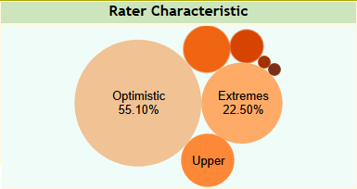
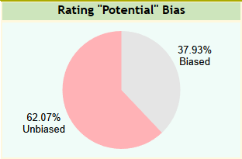
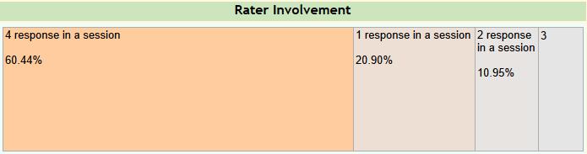
Step 2: Data Visualization
Rater Characteristic Dashboard
If Rater has given same rating for all 4 item in his basket then it has been considered as user bias.
If(:Name("N(Rank)") == 4, "Biased", "Unbiased")
Banding of Rater’s Rating Tendency on four ratings
Optimistic: Ranked all 4 items >=70
Pessimistic: Ranked all 4 items <=30
Upper Half: ranked all 4 items between 50-100
Lower Half: Ranked all 4 items between 0-50
In Decisive: Ranked all 4 items exactly 50
Distributed: Ranked all 4 items randomly
Based on Rater giving rating to all 4 items in his basket in same session or different sessions
Notes:
Another characteristic we could insight was
Each user had to rate 4 items and he could do that in one or multiple sessions. Rating was from 0 to 100 scale.
We identified 6 user behaviour patterns
Optimistic who voted all 4 items above 70
Pessimistic who voted all items below 30
Those who voted upper half from 50 to 100
Those who voted lower half from 0 to 50
Those who were indecisive at 50 for all items
Distributed users who ranked each item across the scale
We also made a judgement on user who gave same rating for all four items as biased
And identified those who gave ratings for all items in one sitting or otherwise.

Slide 12
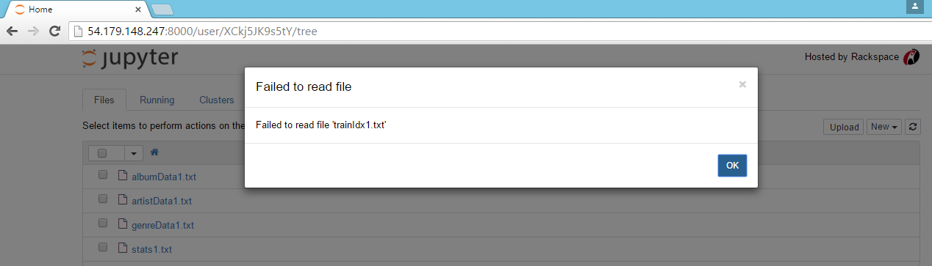
Challenge 1
Uploading 100mB+ data using Jupyter “Upload” option FAILS
Mozilla browser crashes and Chrome fails to read file
WinSCP was used to transfer large files into EC2 Instance
Notes:
Read from slide

Slide 13
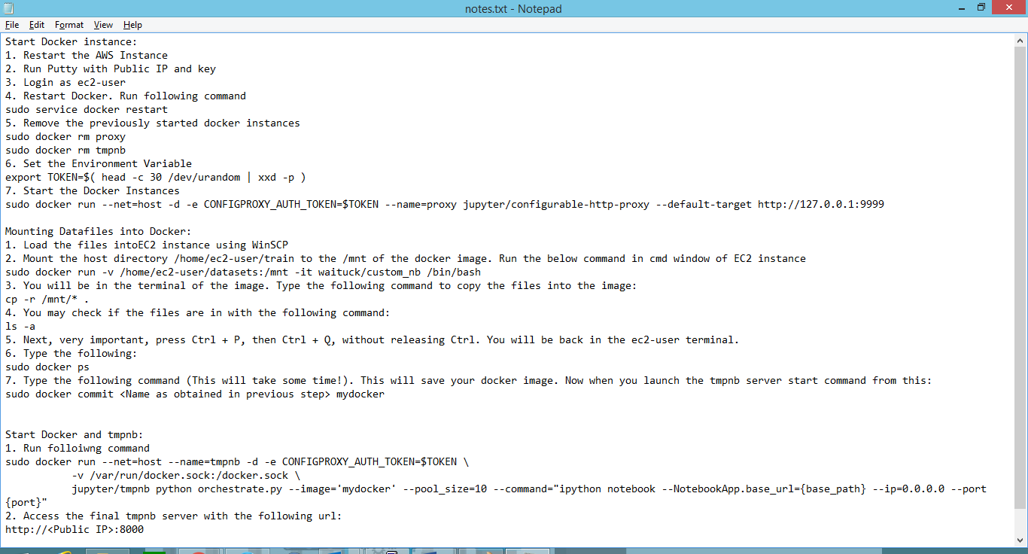
Challenge 2
Datafiles are not visible automatically in Jupyter TMPnB Server once loaded into EC2 Instance
Additional Scripts required to mount data into Docker Image
Scripts need be run every time additional data files loaded into instance
Notes:
Read from slide

Slide 14


Anaconda and Docker
Free (Open Source) Platform
Python Distribution from Continuum
Includes installers for Python 2. 7, 3.4 and 3.5
Available for Windows, OS X & Linux OS
Easy to setup with minimal scripts
Files when loaded in EC2 instance is visible without additional scripts
Package includes Jupyter, Pandas and Matplotlib Among others
Subscription based
Open platform/container for distributed applications
Easily distributable across Environments
Packages application with all its dependencies
Available for Windows, OS X & Linux OS
Files when loaded via winscp is not visible until mounted onto the docker with additional scripts
Can Package Jupyter, Pandas and Matplotlib Among others
Notes:
A quick overview of Anaconda and Docker.
Both are different in its own way. Anaconda is a Python distribution for analytics
Docker is a platform/container for seamless distribution of applications across environments

Slide 15


Summarize
Understanding raters and their voting pattern helps organizers to
Cluster genuinely interested Music Aficionados
Decide on the representative group of raters to be included in survey
plan and time launch of survey
Notes:
To Summarize…
We were constrained with the amount of metadata that was provided in the dataset..From what we had we could deduce certain rater characteristics.
The understanding of rater characteristics will help us identify segments of genuinely interested music aficionados
Help identify representative group of users for future surveys
Also, help plan and time launch of survey

Slide 16

Thank You

